Slide 1
Birmingham City Council
Highways Asset Management Framework and Strategy DRAFT
SUMMARY VERSION

Slide 2
Purpose and context
Like many authorities who establish a Highways Infrastructure Asset Management Framework (HIAMF), this document sets out a strategic architecture for how Birmingham City Council’s (BCC) highways assets will be managed and operated. This encompasses national and regional plans, asset management policy and strategy, asset and operational plans and key enablers for the system.
BCC has to date been reliant on their PFI Contractor to produce core asset management system documents, however, responsibility for this will migrate to the Council as core conditions of their potential future funding model and their constitution as stewards of the highways network. BCC recognise the need to manage the asset well and have adopted the best practice guidelines of the Well Managed Highway Infrastructure: A Code of Practice and the Highway Maintenance Efficiency Programme to ensure the impact of the limited resources available is maximised.
The purpose of this document is:
To describe a proposed asset management framework, including the policies, strategies and plans which are needed, as well as their relationship to each other.
To provide an Asset Management Strategy, which outlines a strategic vision for the management of highways assets and describes the key processes, controls and procedures which are required for managing a safe and reliable asset system.
Translate the draft Asset Management Policy into a strategic approach, defining how BCC will achieve the policy commitments.

Slide 3
Highways Infrastructure Asset Management Framework (HIAMF)

Slide 4
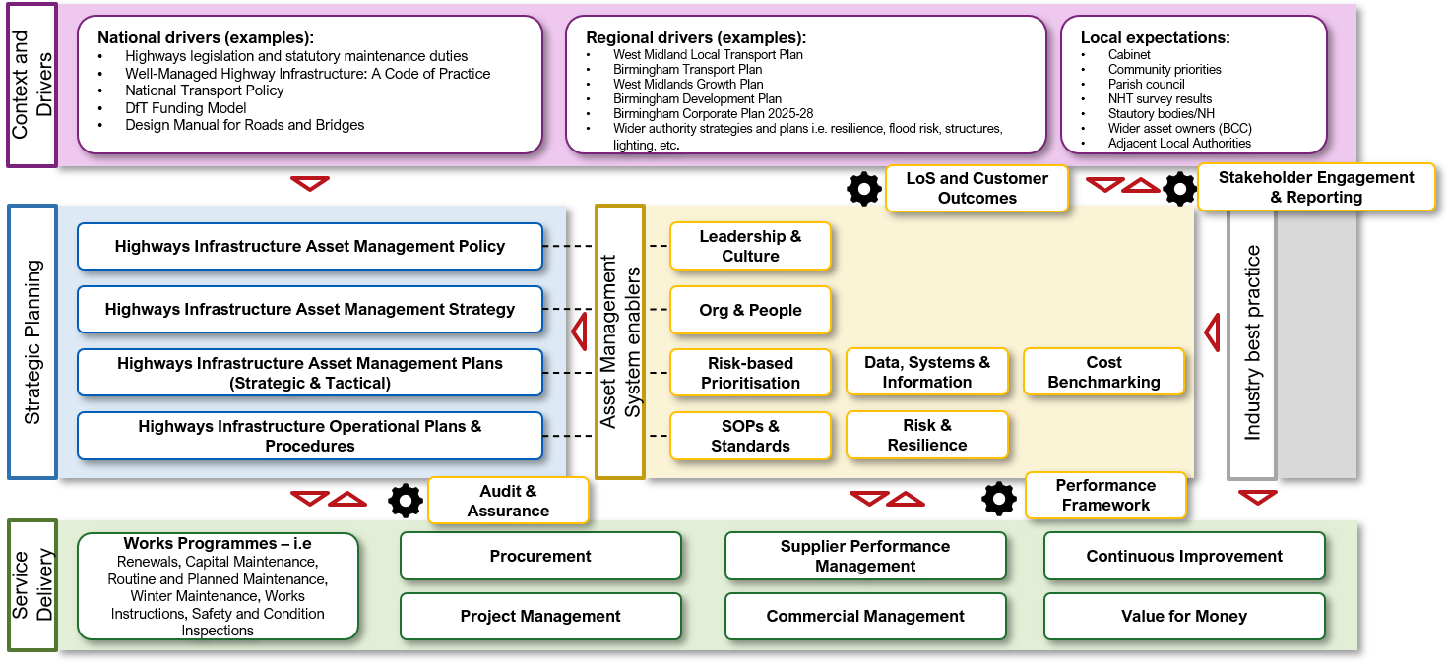
HIAMF design for BCC
This diagram outlines the strategic asset management framework which Birmingham City Council are developing including the context and drivers, key asset management documents and the enablers which support these.

Slide 5
High level purpose of key HIAMF artefacts
Context and Drivers:
The strategic and stakeholder context for the asset management system
Strategic Planning:
The vision for highways asset management
Asset management objectives and associated KPIs
Strategic and tactical asset management plans
Operational plans and procedures required to deliver the strategy and plans
Service Delivery:
The processes required to safely and reliably deliver core asset management services
Asset Management System Enablers:
The key processes and controls which enable strategic planning and service delivery

Slide 6
Highways Infrastructure Asset Management Strategy

Slide 7
Strategy Structure
The contents of the strategy are shown here. The intent is to provide a vision and desired ‘to be’ state for the key processes and controls required to deliver the strategy.
Detailed implementation plans and work programmes are to be included in the asset management planning process.
Sections have been colour coded to show how they align to the HIAMF.
Context Overview
Legislative Landscape
Strategic Landscape
Strategic Drivers
Scope of the AM System
Asset Management Vision & Principles
Asset Management Objectives
Levels of Service
Performance Indicators
Performance Management
Asset Management Lifecycle Planning
Risk-based Prioritisation
Risk & Resilience
Data, Systems and Information
Leadership & Culture
Continuous Improvement
Stakeholder Engagement & Reporting
Strategy Implementation, Review and Update

Slide 8
1. Context Overview
Birmingham has a very large and varied highway asset base, including approximately 2,600 km of roads, 5,000 km of footways, 800 structures and 95,000 lighting columns amongst other asset types, making structured asset management essential.
Birmingham’s transport strategy aims to reduce environmental impact, improve safety, connect communities and support mode shift, so asset management must support not only maintenance, but broader place, mobility, commercial and sustainability outcomes.
Birmingham faces a combination of challenges—ageing assets, funding constraints, climate change risks, and rising customer expectations—all placing increasing strain on available resources, but also creating a clear opportunity to innovate and deliver more resilient, sustainable outcomes.

Slide 9
2. Legislative Landscape
BCC Highways asset management and operational activities are governed by a range of legislation, with selected key examples outlined below.
Highways Act (1980)
Traffic Management Act (2004)
New Roads and Street Works Act (1991)
Road Traffic Regulation Act (1984)
Infrastructure Act (2015)
Town and Country Planning Act (1990)
Environmental Protection Act (1990)
Climate Change Act (2008)
Flood and Water Management Act (2010)
Road Tunnel Safety Regulations (2007)

Slide 10
2. Legislative Landscape (cont.)
In addition, there are codes and guidance which, whilst not formally legislation, are essentially mandatory in practice.
Well-Managed Highway Infrastructure (UKRLG Code of Practice)
Highway Infrastructure Asset Management Guidance (HMEP)
Design Manual for Roads and Bridges (DMRB)

Slide 11
3. Strategic Landscape
The following key strategy documents provide key drivers for the management of Birmingham highway assets.
Birmingham’s Corporate Plan for 2025-2028
West Midlands Growth Plan
West Midlands Local Transport Plan
Birmingham Development Plan 2031
Birmingham Transport Plan 2031

Slide 12
3. Strategic Landscape (cont.)
There are a number of converging themes across these strategies and plans:
Growth and connectivity: Highways must enable economic development and labour mobility with a strong emphasis on strategic corridors and access to development sites.
Shift away from car-dominated networks: Increasing emphasis on public transport and active travel
Integration of transport and place: Streets are seen as places for people and enablers of community outcomes
Decarbonisation and sustainability: All documents highlight climate change, air quality and low-carbon transport
Outcome-focused approach: Shift from the delivery of engineering outputs to wider customer and societal outcomes i.e safety, accessibility, reliability and economic growth
Value for money and affordability: Recognition of the strain on the public purse and the need for the efficient allocation of resource and focus on return on investment (ROI)

Slide 13
4. Strategic Drivers
Considering the legislative and strategic landscape, a set of strategic drivers for asset management can be synthesised. These are shown below.
Maximising safety and service reliability through whole life asset care
Enhancing asset resilience to extreme weather
Recognising affordability and whole life value for money in TOTEX asset prioritisation choices
Introducing carbon reduction and circular economy thinking into asset management practice and scheme design
Driving an outcome and customer focused approach into decision making with a focus on Level of Service
Creating an auditable and risk-based framework for asset management decision making to guide prioritisation

Slide 14
5. Scope of the AM system
Birmingham City Council manages one of the UK’s largest and most complex highway asset portfolios. A snapshot of the asset base is shown below.
Asset Type | Order of Magnitude
Roads | ~2,600 km
Footways | ~5,000 km
Structures | ~800+
Lighting columns | ~95,000
Traffic signals | ~1,200
Drainage gullies | ~100,000+
Trees | ~76,000
Guardrail / fencing | ~135 km

Slide 15
6. Asset Management Vision and Principles
The Council’s highway network is one of its most valuable infrastructure and community assets. It is essential for a successful city and regional economy. It provides access to jobs, goods and services, as well as to schools, healthcare and leisure activities. While the council has statutory duties to ensure that the network is safe and available to use, the condition of this asset links and contributes to the wider policy objectives of the council.
Our vision for highways asset management is:
To manage Birmingham’s highway infrastructure as a strategic city asset, providing safe, reliable, inclusive, resilient and low-carbon networks that support people, place, prosperity and environmental improvement.
Aligned with industry best practice (ISO55000), the core asset management principles which will guide our thinking and decision making are:
Whole-life TOTEX cost optimisation
Total value approach
Customer and outcome approach
Evidence led and data driven
Right intervention, right time

Slide 16
7. Asset Management Objectives
Our Asset Management Objectives translate corporate and regional drivers and objectives into tangible and measurable outcomes which can be targeted through best practice asset management. These are shown below.
AM01: Maintain a highway network that minimises risk of harm and ensures a consistent, reliable service for all users
AM02: Maximise value for money by adopting whole-life (TOTEX) approaches to design, asset investment, balancing cost, commercial benefit, performance and risk within available funding.
AM03: Improve the resilience of highway assets to climate impacts and extreme weather, ensuring critical networks remain operational.
AM04: Minimise the carbon impact of highway asset management and embed circular economy principles in design, maintenance and renewal.
AM05: Deliver a service that reflects customer needs, expectations and wider place-based outcomes, taking into account the diversity across the City.
AM06: Prioritise asset investment to support economic growth, connectivity and access to key employment, development and strategic corridors.
AM07: Ensure asset management decisions are transparent, evidence-based and auditable, using consistent risk and performance frameworks.
AM08: Embed innovation and continuous improvement into asset management practice through the use of new materials, technology anprocesses.

Slide 17
8. Levels of Service
Levels of Service (LoS) are used to translate strategy into measurable outcomes. They are a set of customer and outcome focused statements defining the service the highway network should provide. LoS statements are shown below aligned to the respective asset management objectives.
AM01: The highway network will provide a safe and reliable environment for all users, with risks managed through timely inspection, maintenance and intervention.
AM02: Highway assets will be managed to maximise whole-life value, balancing cost, performance and risk to deliver an affordable and sustainable service.
AM03: The highway network will be resilient to disruption and adaptable to the impacts of climate change, maintaining functionality during and after extreme events.
AM04: Highway assets will be managed to minimise environmental impact, reduce carbon emissions and promote sustainable and circular practices.
AM05: The highway network will deliver a level of service that reflects the needs and expectations of customers, communities and stakeholders.
AM06: The highway network will support economic growth and connectivity by enabling efficient movement of people and goods.
AM07: Highway asset management decisions will be evidence-based, transparent and auditable, ensuring consistency and accountability.
AM08: User of the Highway network and local communities will benefit from an evolving and constantly improving approach to highways maintenance and works delivery.

Slide 18
9. Performance Indicators
PIs provide a means to measure the successful delivery of objectives and corresponding Levels of Service. These can be both leading and lagging indicators. Specific PIs can be termed KPIs for reporting and audit purposes.
AM01
  Leading PIs (examples): % of safety inspections completed on time; % of high risk defects repaired within SLAs
  Lagging PIs (examples): KSI rates; Number of third party claims
AM02
  Leading PIs (examples): % of planned vs reactive maintenance expenditure; % of asset classes with lifecycle plans in place
  Lagging PIs (examples): Total cost per km of network (trend over time); % of network in target condition bands
AM03
  Leading PIs (examples): % of network with resilience plans in place; Number of known resilience risks mitigated
  Lagging PIs (examples): Number of flood related incidents; Network disruption due to weather events
AM04
  Leading PIs (examples): % of schemes using recycled/low-carbon materials; Embodied carbon per scheme (£/tCO2)
  Lagging PIs (examples): Total carbon emissions from highways maintenance (tCO2/year); Reduction in annual emissions
AM05
  Leading PIs (examples): Customer complaints responded to within target time; % of LoS measures actively monitored
  Lagging PIs (examples): Customer satisfaction score; Number of complaints per 1000 population

Slide 19
9. Performance Indicators (cont.)
AM06
  Leading PIs (examples): % of investment aligned to strategic corridors/growth areas; Average journey time reliability on key routes
  Lagging PIs (examples): Congestion measures; Travel time to key employment areas
AM07
  Leading PIs (examples): % of decisions supported by data/asset management systems; Data completeness/quality in asset inventory
  Lagging PIs (examples): Audit compliance; Reduced challenge/dispute over investment decisions
AM08
  Leading PIs (examples): Number of innovation ideas identified; Number of innovation trial/pilots implemented
  Lagging PIs (examples): Improvement in asset performance attributable to new materials, technology or processes; % reduction in process cycle times due to new technology or improved process

Slide 20
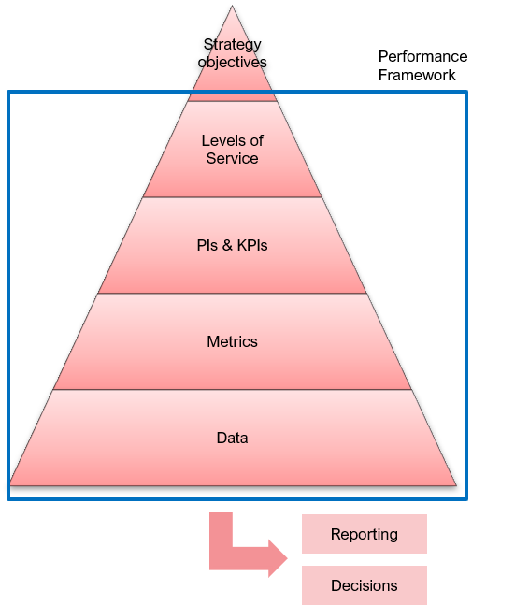
10. Performance Management
A Performance Framework is the system which allows authorities to manage PIs and KPIs. This includes agreed targets, dashboards used to monitor PIs and the governance process by which these are reported on and corrective actions are implemented.
Data and information aligned to the agreed PIs will be monitored through Service Delivery and tracked in a dashboard to allow timely and appropriate action in the event that a PI is not being met by the agreed target.
Because the PIs have been designed to align to LoS, the Performance Framework will enable customer and outcome focused decisions to be made.
The Performance Framework will enable a Balanced Scorecard to be populated and used for reporting to key stakeholders.

Slide 21
11. Asset Management Lifecycle Planning
Our Lifecycle planning process will:
Maximise whole life (TOTEX) value
Maintain assets at the right condition, at the right time
Support risk-based decision making
Align with LoS
Provide a transparent, evidence-based approach to investment planning
Incorporate environmental and social value into decision making
Apply a systems view of the network
Lifecycle planning will operate across a range of planning horizons.
Long term (10-25+ years): Whole lifecycle modelling
Medium term (3-5 years): TOTEX investment plan
Short term (0-3 years): Delivery and operational planning (tactical)

Slide 22
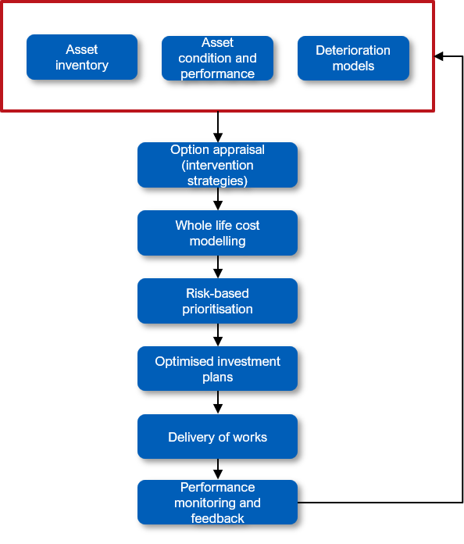
11. Asset Management Lifecycle Planning (cont.)
The proposed lifecycle planning process is shown on this page.
The process initiates from an asset inventory which is regularly updated through inspection and work orders as per asset type care plans. Deterioration models provide forecasting tools to predict intervention points.
Whole life cost modelling provides a TOTEX view of like-for-like long-term value.
Risk-based prioritisation then allows a workbank to be constrained based on agreed value metrics. This is explored further on the following page.
Optimised delivery plans can then be created and delivered.

Slide 23

12. Risk-based Prioritisation
Decisions on what interventions to undertake should be done using a risk-based approach. There are 2 broad components of this approach – likelihood and consequence.
A proxy for likelihood is Asset Health. Asset health can be determined from a range of factors including condition, performance i.e. failure rate or number of disruptions, annual maintenance cost, backlog trend, resilience factors, customer satisfaction. Asset health is a more robust metric than condition alone however this can be used in the absence of other metrics.
A proxy for consequence is Criticality. This can be within an asset type i.e an A-road is more critical than an unclassified road and so a similar defect should be prioritised on the A-road first. Certain roads are also part of an active travel or public transport network which further adds to their criticality. Criticality can also be between asset types i.e pavement is more critical than fencing.

Slide 24
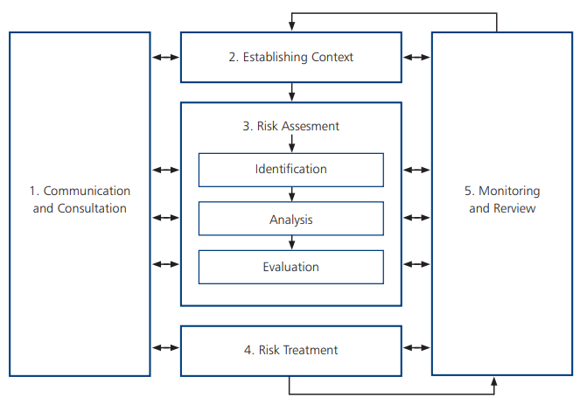
13. Risk & Resilience
A risk can be defined as an uncertain event which influences the desired performance of an asset or the Level of Service provided by the asset base. It consists of a combination of the likelihood of a perceived threat or opportunity and the magnitude of its impact.
The most commonly understood type of risk is safety however there are a variety of other risk types which might arise from highways assets:
Reputation
Asset loss or damage
Service reduction or failure
Operational
Environmental
Financial and contractual
Risk management must influence decisions on:
Providing different levels of service
Redistributing funding between asset groups
Intervention choices i.e. renew vs maintain
Interventions in the asset management framework
Birmingham City Council’s risk management process should follow ISO33001 (as outlined in the diagram here).

Slide 25
13. Risk & Resilience (cont.)
Resilience is the ability of the highways network to anticipate, withstand, adapt to and recover from disruption, including extreme weather and climate-related impacts.
Key resilience risks for Birmingham’s highways network include:
Flooding and surface water: leading to road closures, damage to assets and safety risks
Heat stress: leading to accelerated deterioration of key assets including pavement and structures
Ageing assets: older assets are more vulnerable to failure, particularly in the context of higher traffic loads and urban pressures
These risks can cause increased network disruption which directly impacts economic activity, emergency access and prevents the required Level of Service being delivered for customers.
Strategic priorities are to reduce the vulnerability of assets to climate risks, better maintain service continuity for critical parts of the network and improve recovery times following disruption.
This will be done through:
Developing a network-wide risk profile for resilience risks
Considering future climate scenarios within investment planning
Designing for changing climate risk
Review and update incident response and recovery processes with the aim of recovering network performance as rapidly as possible post an event.

Slide 26
14. Data, Systems and Information
Asset data is crucial to make informed, consistent and auditable decisions. The following principles will be adhered to in future planning regarding data, systems and information.
There will be an Asset Information Strategy and agreed data hierarchy specifying data specification requirements, quality levels, audit requirements and relevance to business critical decisions.
There will be a clear handover and handback process for capital projects and supply chain.
There will be a single Enterprise Asset Management system which acts as the master asset register and enables works management in line with business processes. Currently this is EAP, procured via Brightly. This system should be reviewed to evaluate whether it meets the future needs of highways asset management.
Modelling modules or packages will be integrated within the EAM solution i.e. Brightly’s Predictor module and used to inform decision making. This can be a combination of different solutions and a decision should be made on suitability for the required decisions.
A GIS platform will be used in conjunction with the EAM solution. This enables geospatial analysis and works planning.
Data sharing agreements will be in place with all parties involved in highways asset management to avoid data loss or siloed data.

Slide 27
15. Leadership & Culture
It is essential to foster a culture where asset management principles are embedded across all levels of the organisation, and supply chain partners, ensuring consistent, evidence-based decision making that delivers value for money, agreed Levels of Service and long term asset sustainability. Key principles of asset management leadership and culture:
Visible leadership: senior leaders will champion asset management as a core business approach
Clear accountability: there are defined roles and responsibilities for asset management
Strong governance: there are formal governance structures to oversee performance, approve investment and manage risk

Slide 28
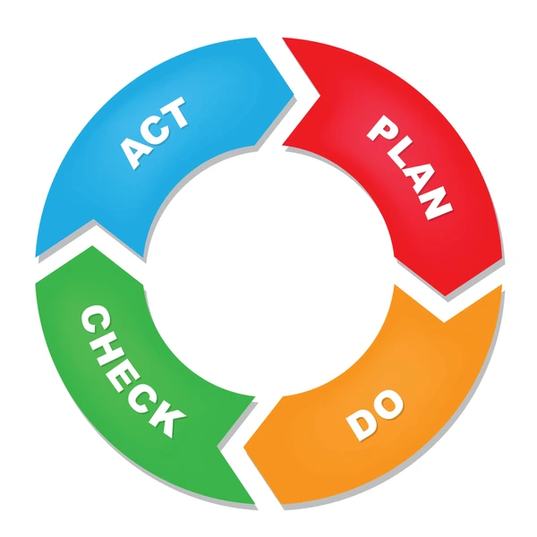
16. Continuous Improvement
Embedding a culture of continuous improvement ensures that asset management processes, performance and outcomes are regularly reviewed, refined and enhanced to maximise value, improve service delivery and respond to changing conditions. A rapidly evolving technology and innovation landscape is providing increasing opportunities for continuous improvement.
Key principles to inform BCC Highways asset management continuous improvement:
Evidence led: Improvements should be driven by data, trends and benchmarking
Outcome focused: Improvement initiative should be aligned to asset management objectives and LoS
Systematic and governed: There should be structured processes for identifying haps, implementing change and tracking outcomes
The Plan-Do-Check-Act model provides a structured, repeatable loop that ensures performance is not only monitored, but actively improved over time.

Slide 29
17. Stakeholder Engagement & Reporting
Effective stakeholder engagement and transparent reporting are essential to delivering a customer-focused, accountable and evidence-led service.
Asset management needs to be informed by the needs of a wide range of stakeholders including:
Residents and communities
Road users
Businesses and freight operators
Elected members
Regional authorities i.e WMCA/TfWM
Central Government
Emergency services
Utility companies and delivery partners
Engagement with these stakeholders will inform the asset management approach and a stakeholder engagement plan should be developed to document the tailored engagement approach for each stakeholder including reporting requirements. A key principle of the engagement plan is to prioritise proactive engagement through providing early insight of planned works and investment priorities as well as open and transparent reporting on delivery performance.
Reporting should be enabled by the performance framework with regular updates on agreed Performance Indicators.

Slide 30
18. Strategy Implementation, Review and Update
This strategy, once finalised, provides the vision for highways asset management. Following acceptance, the anticipated next step are as follows:
Confirm as-is baseline position
Develop a high-level roadmap to build enterprise capability as outlined in the HIAMF
Create a suite of asset management plans for the next 1-2 years, aligned to the overall roadmap
Continue to update asset specific work plans on the current (annual) cycle with a view these enhance and improve as asset management capability develops.
Strategy and plan review timeline:
Asset Management Strategy: 3-5 years
Asset Management Plans: Every 1-2 years
Asset specific plans and work programmes: Annual

