Slide 1
City Wide Housing Strategy 2022-2027
CONSULTATION QUESTIONS

Slide 2
Golden decade of opportunity

Slide 3
We’re Birmingham: our context
Significant scale and size.
Largest city outside London - 1.15m people (89,000 households) and population growing - estimated 150,000 additional people by 2031.
Young and diverse city - Birmingham is the youngest city in Europe and 40% of population aged under 25; most diverse population outside London.
Diversity and youth are strengths and sources of innovation.
Fastest growing economy pre-pandemic but impacted hard by COVID.
40% of economy and population of West Midlands CA area.
Over 100,000 new jobs needed.
407ha of employment land required.
Birmingham City Council is Europe’s largest single-tier authority.
Major transformations taking place and we’re hosting the Commonwealth Games.

Slide 4
A Growing City
150,000 additional people
89,000 additional homes needed.
Current supply of 65,000 of which 19,400 should be affordable
Over 100,000 new jobs needed
407ha of employment land required

Slide 5
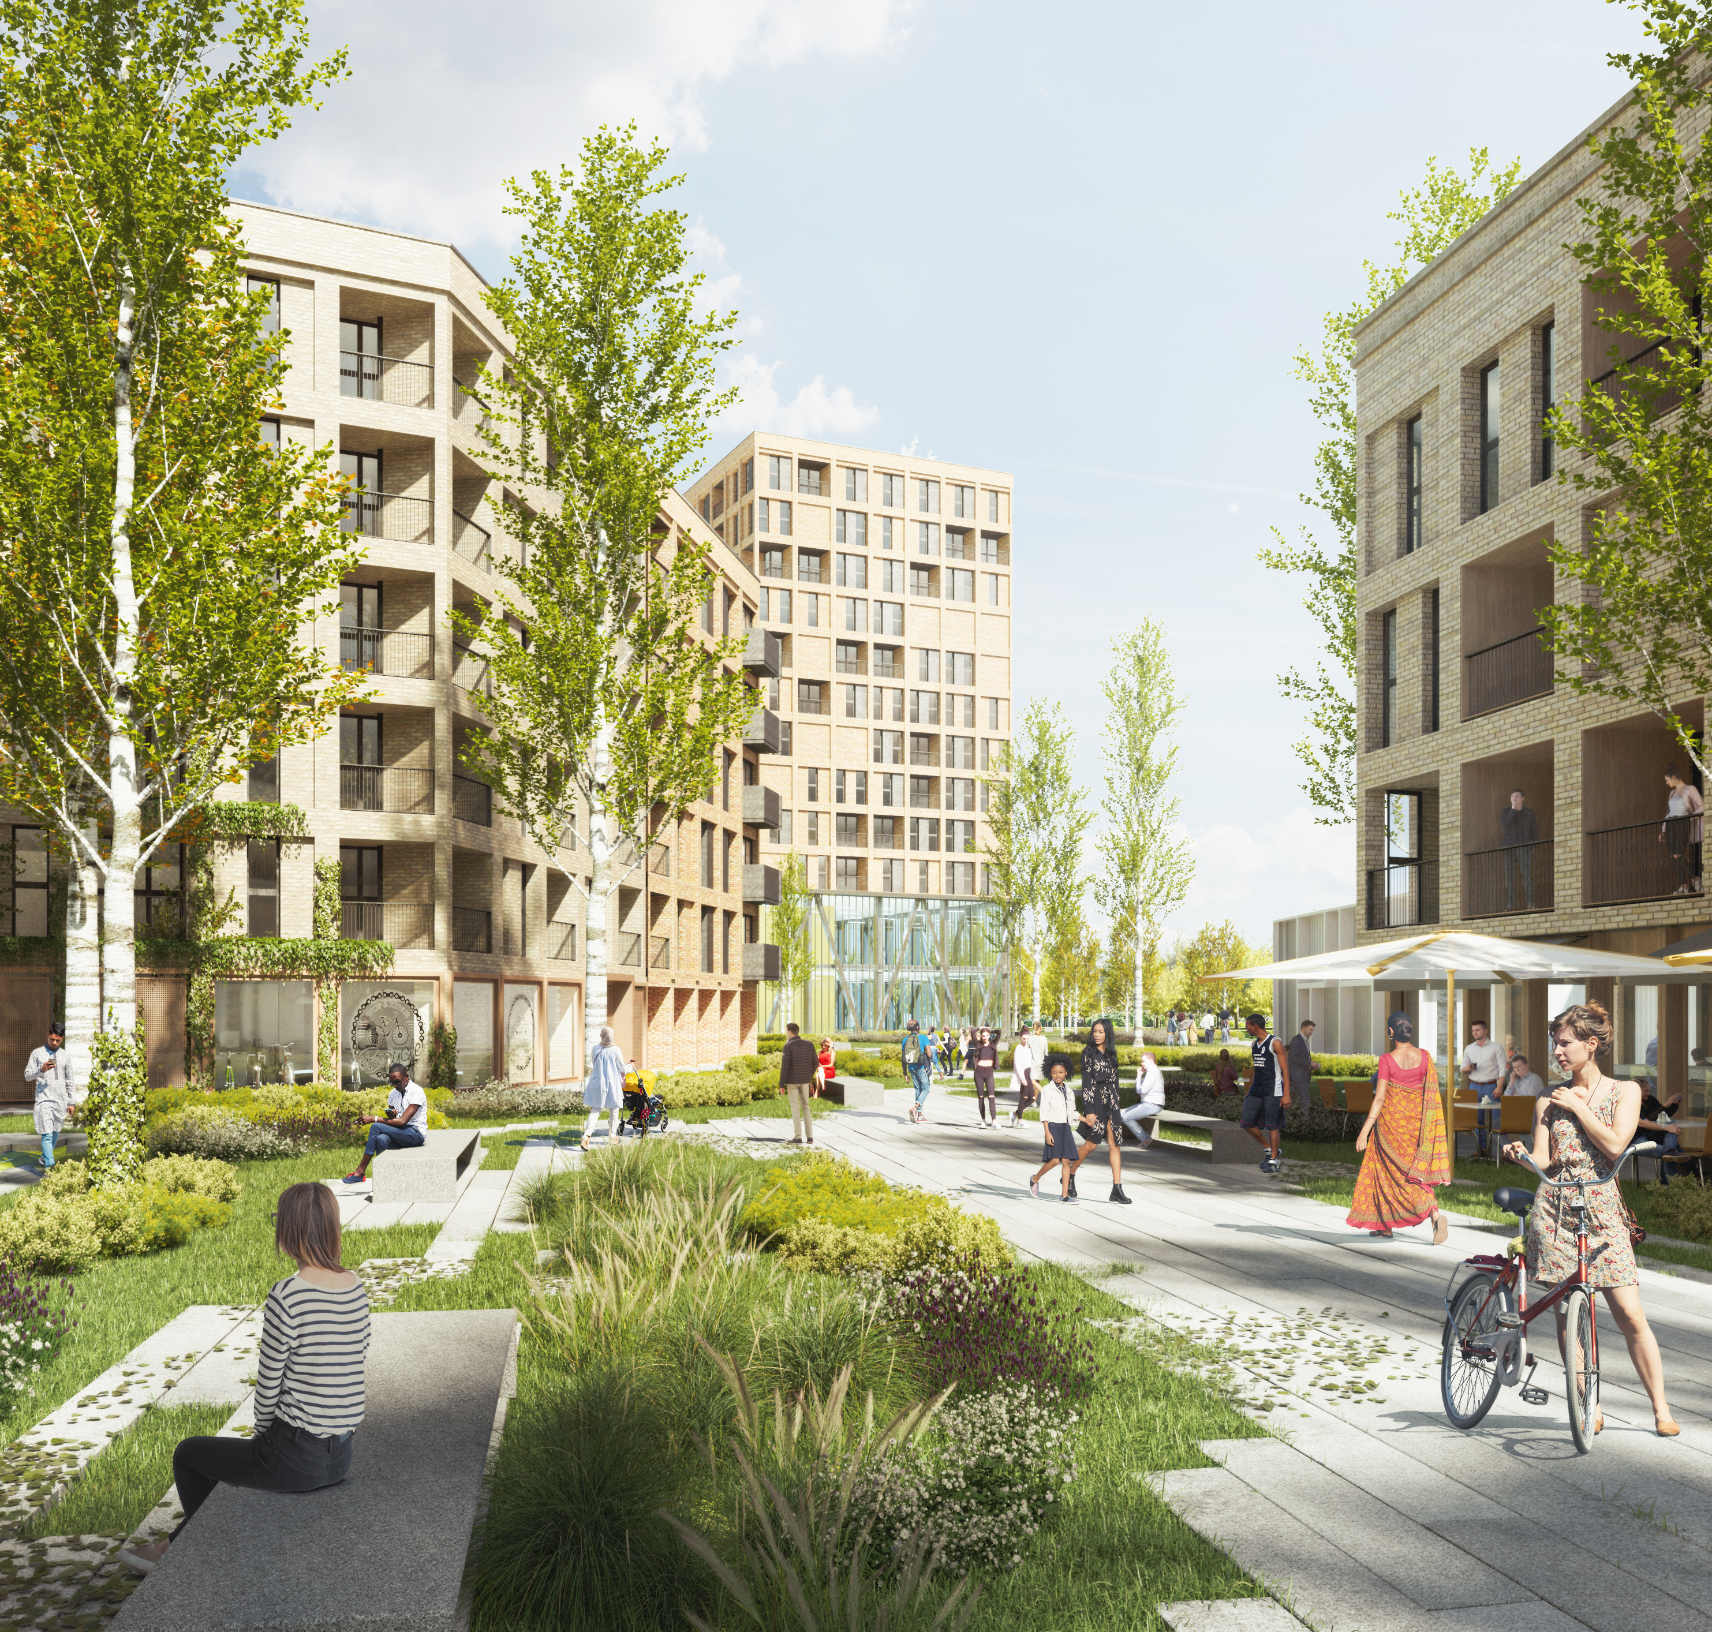
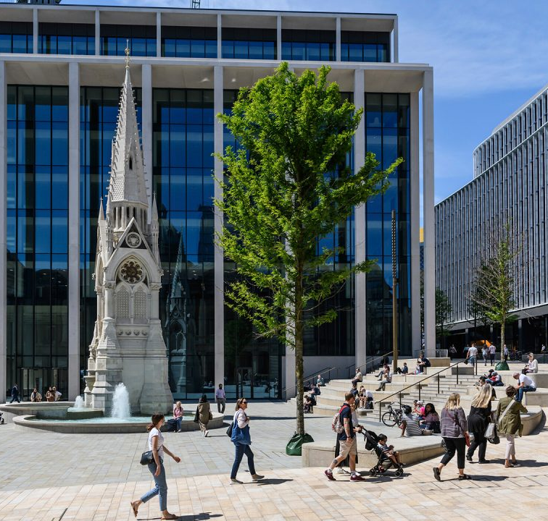
Confidence in Birmingham
Prior to Covid growth at twice the rate of London and three times the UK average.
Significant investment in infrastructure, HS2 and Metro
Host city for 2022 Commonwealth Games
UK’s best performing region for foreign direct investment (2020/21), 38 projects secured creating 2,263 new jobs
Attracted major investment projects including Department of Transport and Goldman Sachs
More new business start-ups than any other city outside London

Slide 8
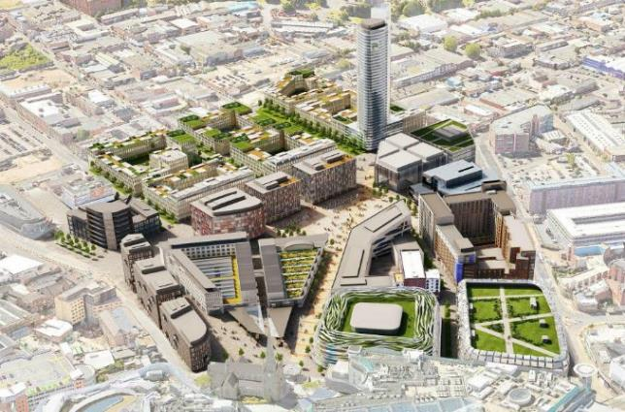
Growth programmes
BCC investing £3.5bn to help deliver CWG, make city heart of the HS2 network, and deliver 51,000 homes and 253ha of employment land.
Working with partners to deliver large development programmes to spur new homes, employment space, community facilities, environmental improvements and growth and jobs.
Programmes include:
Spotlight on: Smithfield, Martineau Galleries, Oval Estate - will deliver:
6,000 homes
4,000,000+ sqft of commercial floorspace
35,000 jobs
£1bn+ boost to the local economy
Smithfield
Digbeth
Perry Barr
Langley
Longbridge
Peddimore
Arden Cross
Millennium Place
Bordesley Park
NEC
Greater Icknield
Druids Heath
Birmingham Health Innovation Campus
Oval Estate

Slide 9
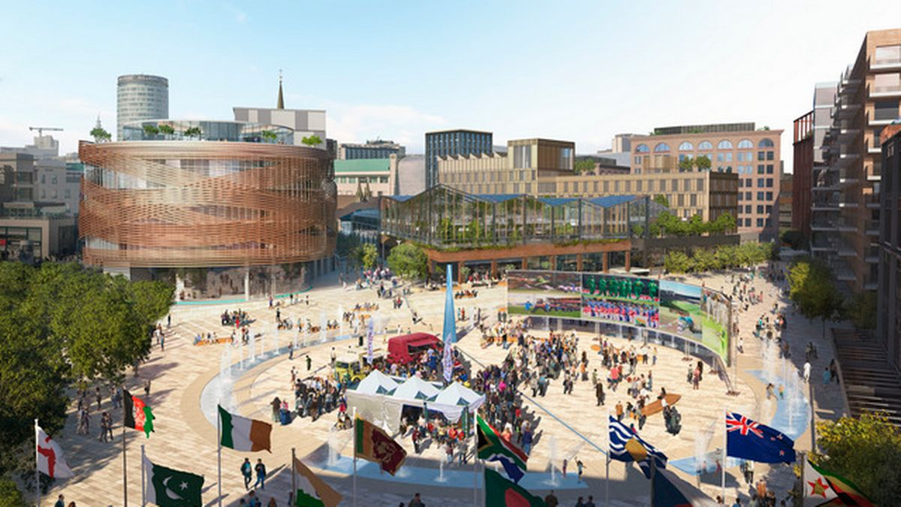
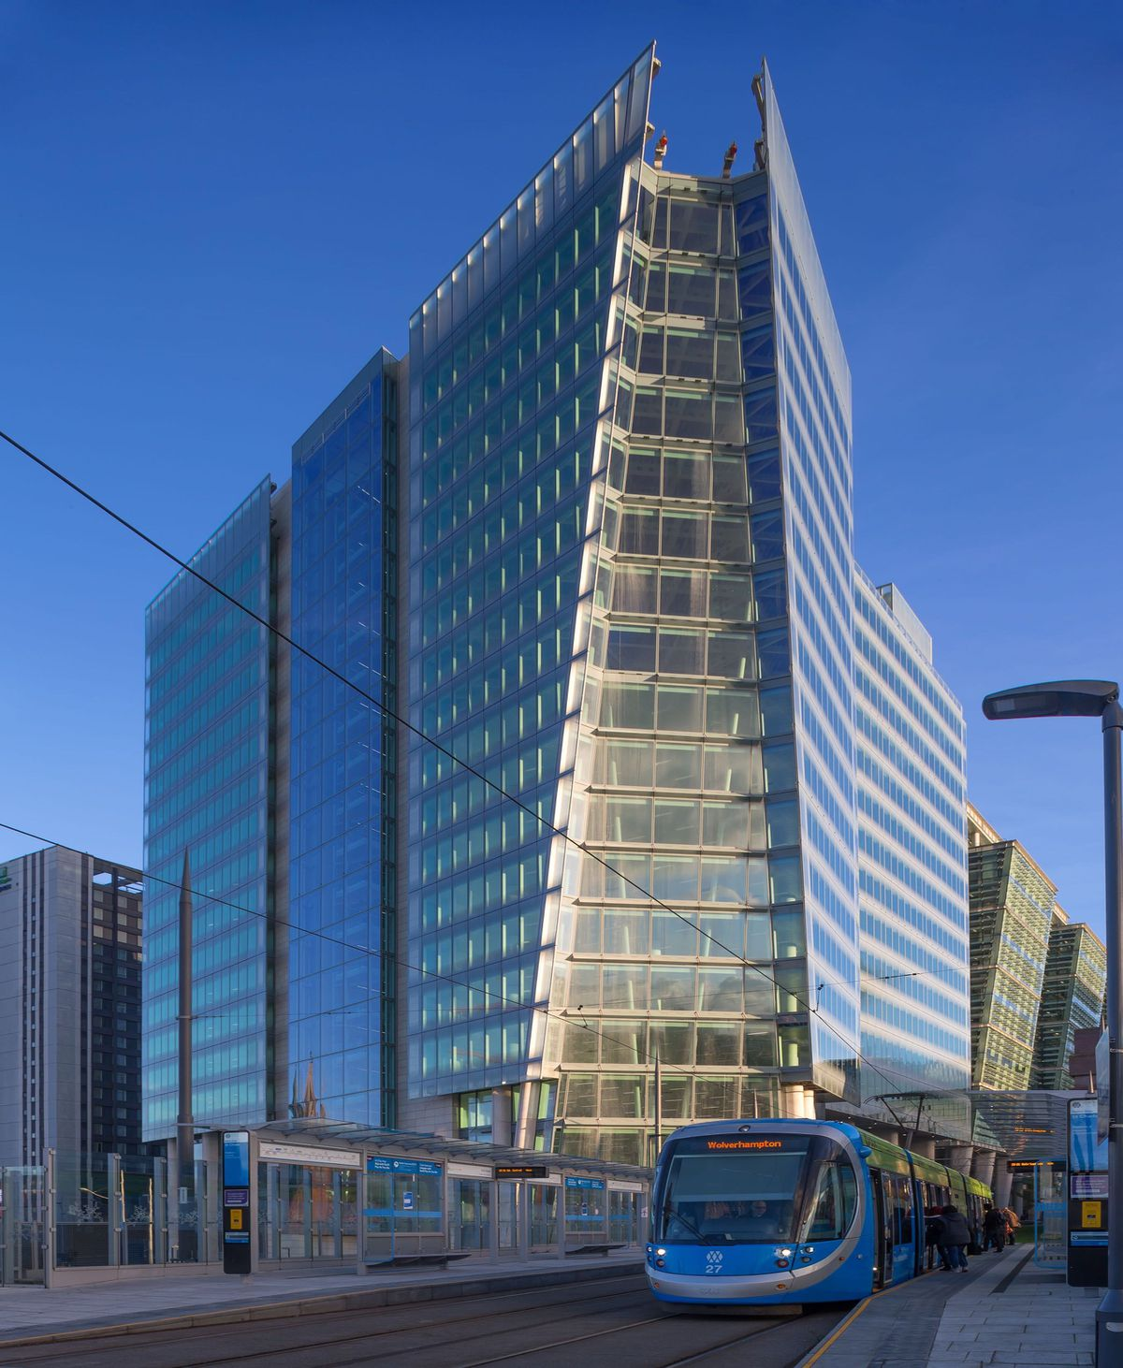
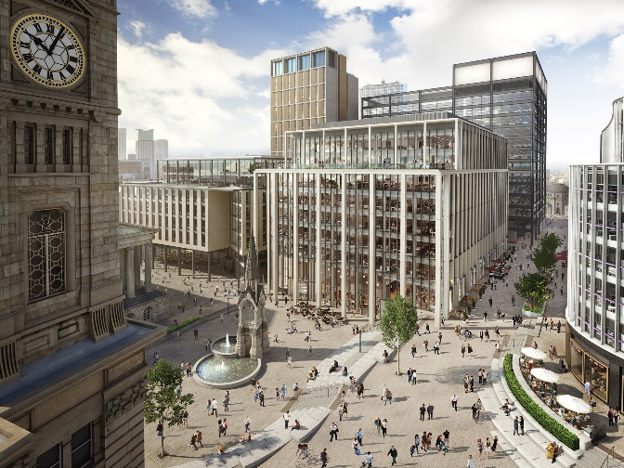

Slide 10
Levelling up strategy: prosperity and opportunity for all
Strategy published November 2021.
Levelling up central to BCC’s aims and anchored in existing strategies including corporate plan.
Wanted to lead not follow hence issuing strategy ahead of government’s White Paper.
Birmingham’s voice is important - significant needs, 1.15m people and size of council.
Strategy an ‘investment prospectus’ not begging bowl. We’re:
Harnessing and delivering the best Commonwealth Games.
Maximising the benefit of HS2.
Harnessing the city’s energy, innovation, diversity and youth.
Have ‘skin in the game’ - bringing forward and delivering large development programmes.

Slide 11
A new Housing Strategy

Slide 12
Vision ‘Making Birmingham a great place to live’
City owned Housing Strategy that makes a real difference to lives of the people that live in Birmingham
A cross-council initiative addressing both development of new stock and our existing stock
A strategy with citizens at the heart of it
Achieve a step change in the number of new homes built
Drive up the quality of housing for all citizens across Birmingham
Ensure that housing delivers wider community benefits and contributes to the city
Connecting people to an improved housing offer
Keep tenants safe, ensure they are listened to and live in good quality homes
Promote the preservation, rehabilitation, and investment in our housing stock and neighbourhoods
Accelerate affordable housing delivery within the city
Contribute to the levelling up agenda by working together to reduce inequalities in the housing market

Slide 13
PRIORITY 1 – Supply

Slide 14
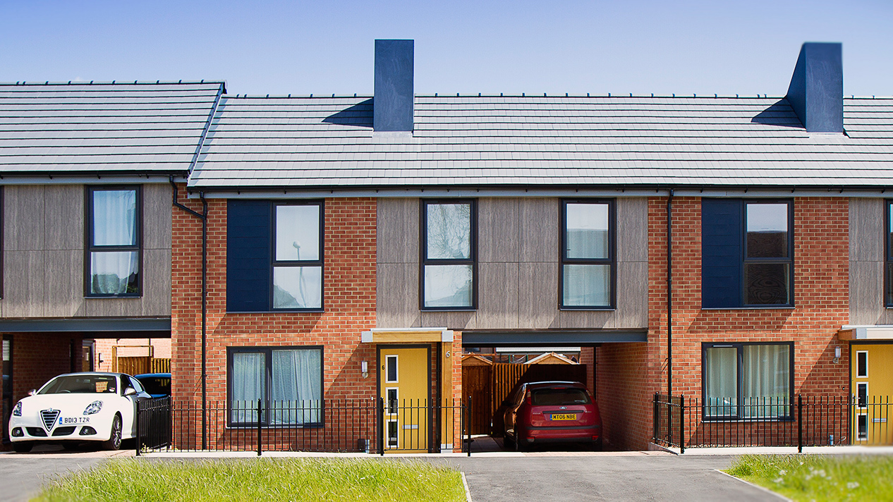
Priority 1- a strong supply of genuinely affordable homes
Open for business
Call to arms- stronger together
Enabling delivery
What are the drag factors?
Suggested solutions

Slide 15
Current Performance
Requirement of 51,100 net new homes to be provided within Birmingham by 2031.
The cumulative requirement for the period 2011/12 to 2020/21 was 22,650 dwellings.
A total of 26,175 net new dwellings were completed in this period, thus exceeding the target by 3,525 dwellings.
However, of the 51,100 dwellings requirement some 38% (19,400) have been identified as needing to be affordable homes.
To date a total of 4,395 affordable dwellings have been completed between 2011/12 – 2020/21 against a requirement of 8,607 for this period.
Of the 4,395 affordable dwellings provided in the city to date 2,070 (x%) of these have been delivered by the council’s BMHT direct delivery programme.

Slide 16
What are the drag factors?
Historically low land value and patchy inward investment interest
Complex site delivery and no such thing as ‘low hanging fruit’
Disjointed strategy for the provision of housing across the City
Over reliance on narrow range of partners
Capacity and capability – commercial, major projects, estate regeneration, strategy
RP’s can choose to develop in many areas

Slide 17
What are the key workstreams?
Strengthen partnerships with RSLs
Develop ‘loss of family accommodation’ policy through the new Birmingham Plan
Mobilise cross directorate Affordable Housing Delivery Board
Efficient use of Empty Dwellings Management Orders and Compulsory Purchase Orders
Collaborate with WMCA to access new sites and investment opportunities
Work with Homes England who now have a wider remit to support LAs in driving up their ambitions for new affordable housing
Expand opportunities for ‘Build to Rent’
Explore models for affordable housing delivery in both the UK and abroad
Work collaboratively with private landlords to incentivise them to work with the council to reduce housing need

Slide 18
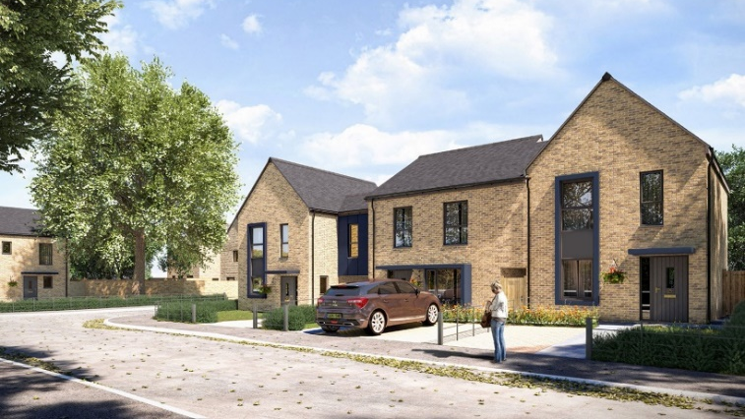
What are some of the solutions?
Refreshed Housing Strategy
Improved approach to Council land ownership
Potential in partnerships
Finance and funding
Remove barriers with RSLs
Enable asset base to increase property growth

Slide 19
PRIORITY 2 - Prevention

Slide 20
Priority 2- citizens can access, sustain and maintain the right home for them
Early intervention and prevention approach
Homelessness and crisis management
Offer for young people
Housing and Health
What are the drag factors?
Potential solutions

Slide 21
How are we currently managing increased demand?
Presentations (Average) | Assessments (Average)
2020 | 2020
272 | 177
2021 | 2021
317 | 211
16% increase | 19% increase

Slide 22
What are the drag factors?
Cost of living crisis and the pandemic have increased homelessness presentations
Large families- restricted accommodation options
Hospital discharge
Poverty and affordability
Impact of the pandemic on the City
Temporary accommodation and move on

Slide 23
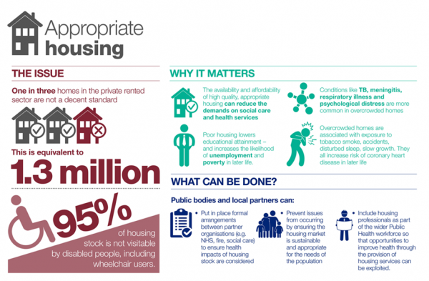
Why is housing and health an important partnership?

Slide 24
Serving a city with a young population
Enable young people to afford to live and work independently
Collaboration with St Basils
Expand live and work schemes
Closer working relationship with schools/colleges- education is key to prevention
Supporting families with dependent children
Think family and early help/ invest in the next generation

Slide 25
What are some of the solutions?
Embed strong housing and health partnerships
Focus on anti-poverty
Expand offer for young people
Resource review with Adult Social Care
Fuel Poverty alliance
Lived experience informs delivery

Slide 26
What are the key workstreams?
Ensure lived experience is a key focal point in developing and delivering services
Ensure poverty within housing is considered in the round, with all key stakeholders as part of larger Anti-Poverty Strategy
Continue to develop the Fuel Poverty Alliance, identifying innovative solutions to tackle fuel poverty in the city
Support the development of the Early Intervention & Prevention model, investing in working upstream to prevent crisis
Develop a temporary accommodation strategy, focusing on moving away from reliance on Bed & Breakfast
Embed Housing Solutions and Support operating model, responding to increased demand
Formally recognise the significant links between housing and health; developing a partnership board that supports delivery related to connected issues
Work collaboratively with St Basils to expand the live and work scheme model, carving out a robust housing offer for young people
Launch new Allocations Policy and regularly review to ensure prioritisation of existing stock
Support the Digital Cities and Adult Social Care agenda by exploring ways in which technology can support people to remain in their home

Slide 27
PRIORITY 3- QUALITY

Slide 28
Priority 3- Neighbourhoods are enhanced and the quality of existing is housing is improved
Commitment to route to zero
Place making
Sustainable communities
Intelligent asset management
Role of the PRS market
What are the drag factors?
Potential solutions

Slide 29
Route to zero- what is the plan?
Addressing fuel poverty, health and wellbeing
Accelerating path to net zero through reduction of housing emissions
Levelling up housing stock and improving standards
Reducing costs of housing maintenance & energy use
Enabling an uplift of skills and developing job opportunities for the benefit of local people
Growing low carbon economy and supply chains
Developing investable proposition
Optimising the benefit of investment to connect with wider policy areas such as digital and energy transformation

Slide 30
What are the drag factors?
Historic lack of investment in our stock
PRS stock condition- how we do drive up quality in the sector?
Affordability & Accessibility
Lack of strategy around asset management/HRA
Poor regulation in the exempt sector
Age and condition of LA stock
Viability vs regeneration

Slide 31
What are the key workstreams?
Deliver whole house retrofit pilot and explore future funding opportunities to embed into existing stock portfolio
Develop Asset Management strategy focused on intelligence led investment
Deliver Housing Revenue Account business plan
Explore opportunities to embed Selective and Additional Licensing in the private sector
Explore funding opportunities to expand the Exempt Accommodation pilot
Continue work to lobby government around regulation of the exempt sector
Develop and embed Housing Management offer, focused on localisation and sustainability within communities
Develop a specific strategy around high rise blocks and the management of these
Collaborate effectively with other authorities/RSLs, adopting best practice in relation to preserving and maintaining existing stock
Improve insight and intelligence into the way properties are let, focusing on building communities that are mixed and sustainable
Embed 5 year rolling stock condition survey programme, using intelligence to inform investment

