Slide 1

What to do with
“What’s On South Brum”?

Slide 2

What is ?
One place to find out what’s on for young people
One place to find information to help with provision planning and delivery
Just me
  Requesting and chasing content
  Uploading and adding activity listings
  Adding and creating information and links
  Promotion

Slide 3
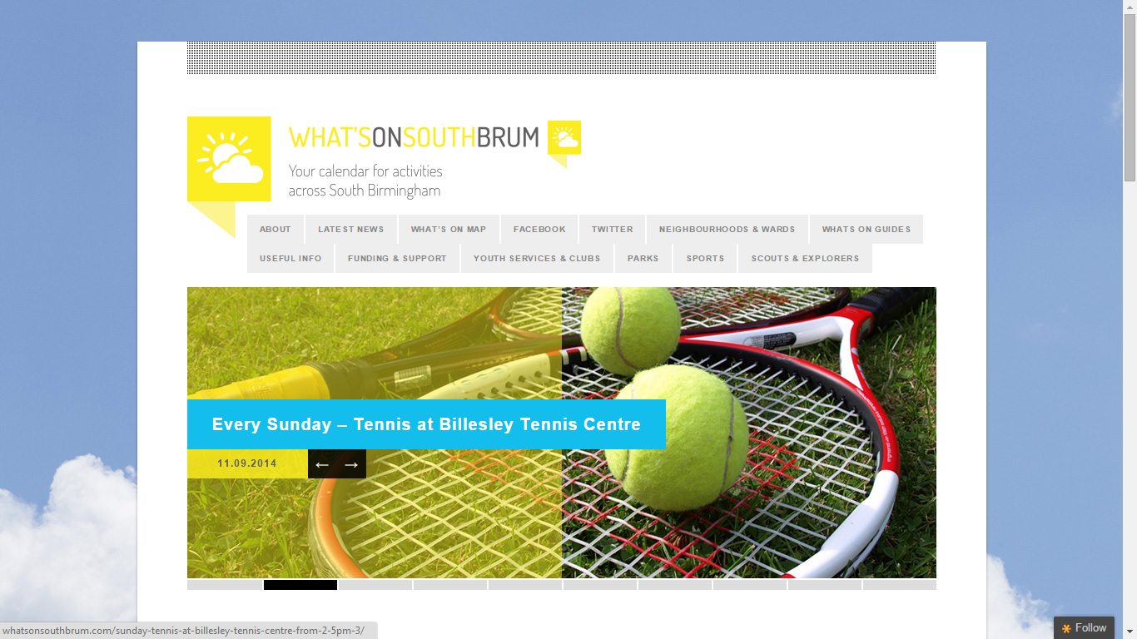
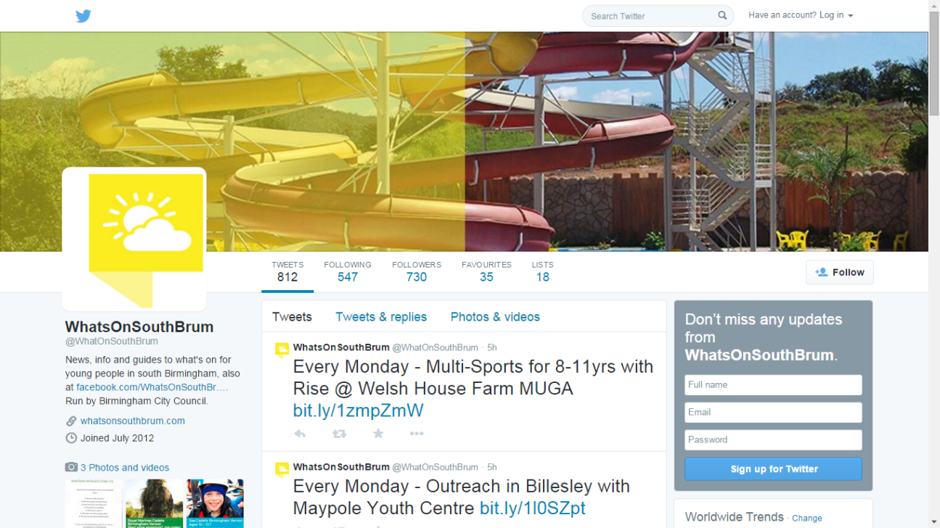
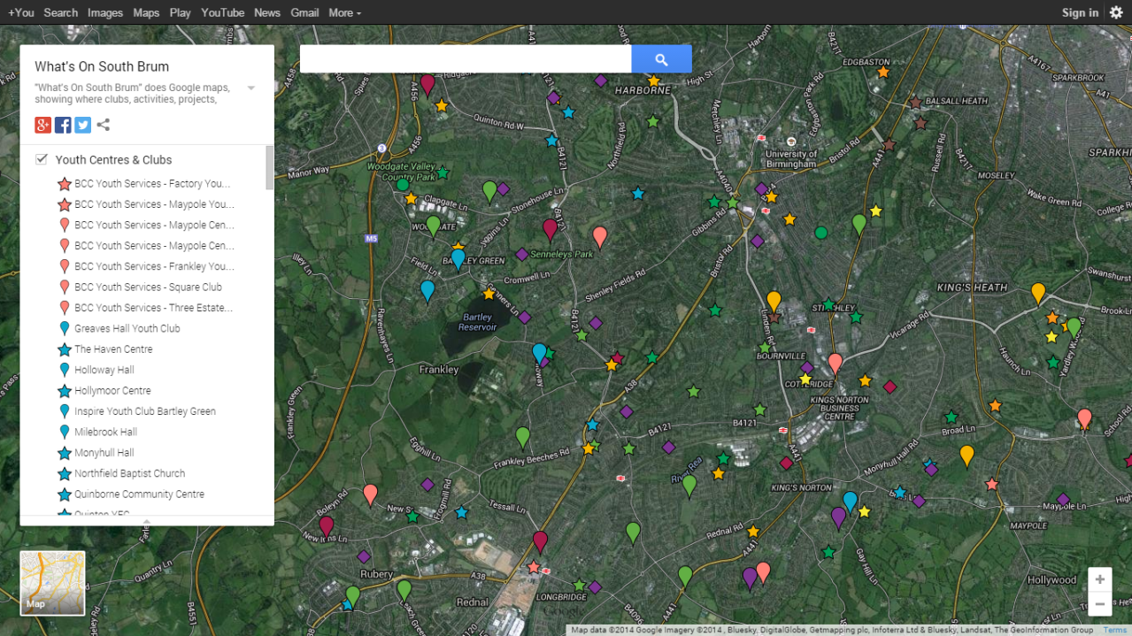
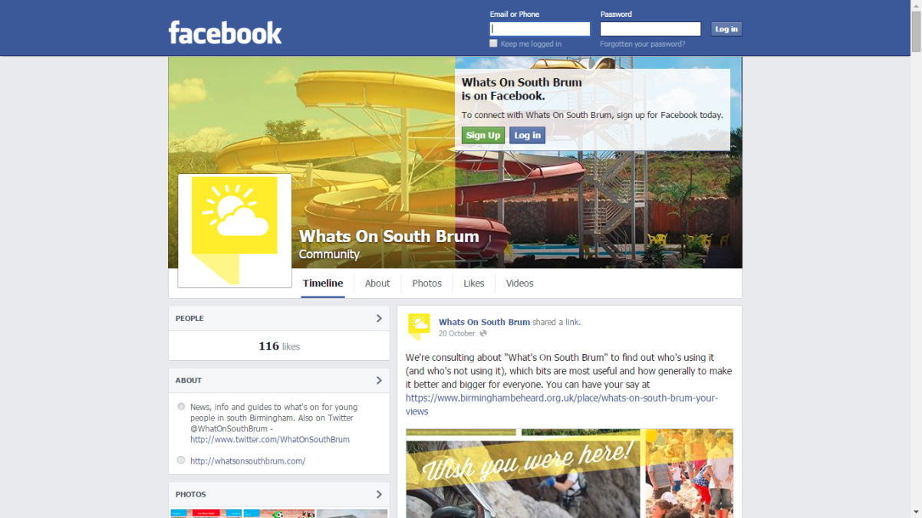

Slide 4

History
Summer 2012 – simple blog and trial between a few providers
Spring 2013 – concept discussed and supported with schools
Summer 2013 – launch with 1,331 users of the website; over 300 activity sessions included; 267 Twitter followers from first summer
Autumn 2013 – Additional information added for practitioners, e.g. funding news, activity providers, parks and sports info.
Spring 2014 – Schools started adding links onto websites.
Summer 2014 – Renewed push on activity listings, processes streamlined (“Every Monday…”). Trial of a “What’s On South Brum” school tour. Beyond holiday periods.

Slide 5
Summer 2014 – where are we now?
847 users; 2,475 views of content; over 500 activity sessions listed; nearly 700 Twitter followers; Over 100 Facebook “likes”/subscribers
  Drop in use by nearly 40%, due to lack of capacity to push and promote through local bloggers (B31 Voices, B’ham Updates)
Calendar and website being maintained now on weekly basis – nearly 586 users since 1st September and nearly 70 activities on the weekly calendar

Slide 6
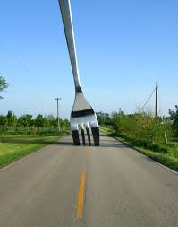
What NEXT?

Slide 7

Moving from this

Slide 8
To one of…
Decommission “What’s On South Brum” in May 2015, when the current domain runs out?
A low maintenance version of “What’s On South Brum”, creating a static sign-posting website, removing Facebook?
Maintain the current design and tools (website, Google Maps, Twitter, Facebook) but develop a collaborative, multi-user approach to updating and adding content?
Review and improve the whole design and layout of “What’s On South Brum” tools, as well as invest in a part-time administrator/coordinator?
Develop “What’s On South Brum” into a social enterprise, generating income to maintain the site and functions, as well as potentially re-invest into local youth provision?

Slide 9
Consultation – good info leads to good decisions?
23 responses - nearly all existing users; good mix across sectors and geographical areas
Might be limited in terms of what comes next

Slide 10
Consultation headlines
Most used
  Monthly – Latest news; Funding info; Web-links; Youth services and clubs; Google Map; Twitter
  Holidays – Calendar; Youth Services & Clubs; Google Map; Twitter
  Never – Calendar; Funding info; Web-links; Parks; Sports; Scouts; Google Map; Facebook; Twitter
Ratings – mostly good
  Excellent – Range and type of activities on the calendar; Information pages
  Good – Logo and branding; Website design and layout; How easy the website is to use; Funding news and info; News and info
Promotion – word of mouth and e-mail

Slide 11
Ideas & Contributions
Need to tailor the site and use to different users
  Different accessibility for different users
    E.g. Easy access info for young people
    E.g. Activity providers/practitioners updating own info
  Reflect this in some tweaks to the design and layout
Content
  Maintain the type of info that’s already on there
Promotion
  Need to do more to promote it with young people and families
Partnerships and collaborations
  Explore joint enterprise opportunities with other bloggers, e.g. B31 Voices, or platforms, e.g. Filter Me and Ideas Tap

Slide 12

Next steps
Keep people involved and updated
  70% want regular updates and info by e-mail; 40% would help by taking part in further consultation
  Most want to help with promotion
Develop “steering group” to put ideas and feedback into practice
  Involve those people who said they want to be part of a planning event/meeting
  Involve those who people who said they would want to help run/administrate the site

Slide 13

The End
Thank you

